Slide 1
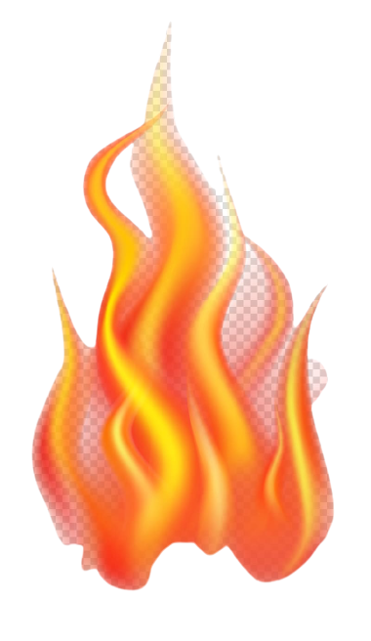

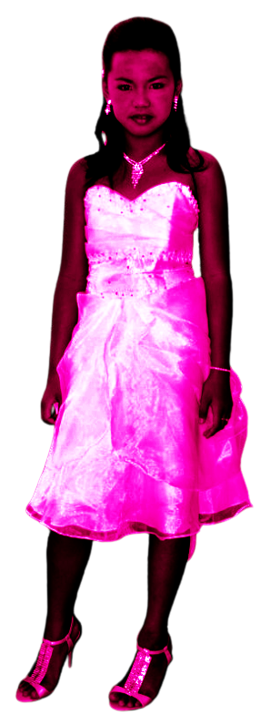

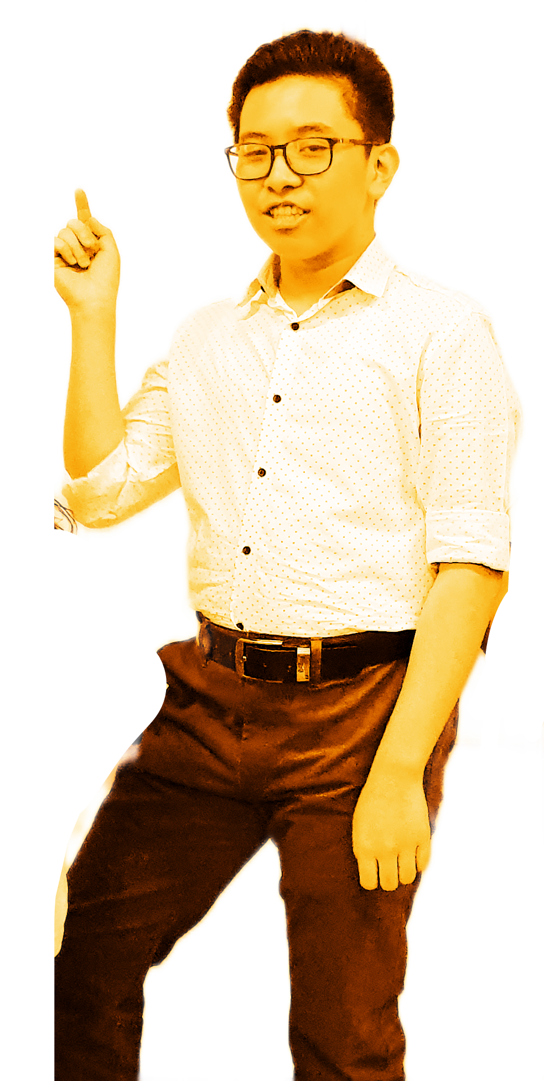
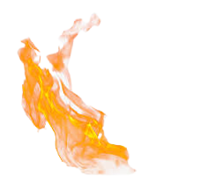
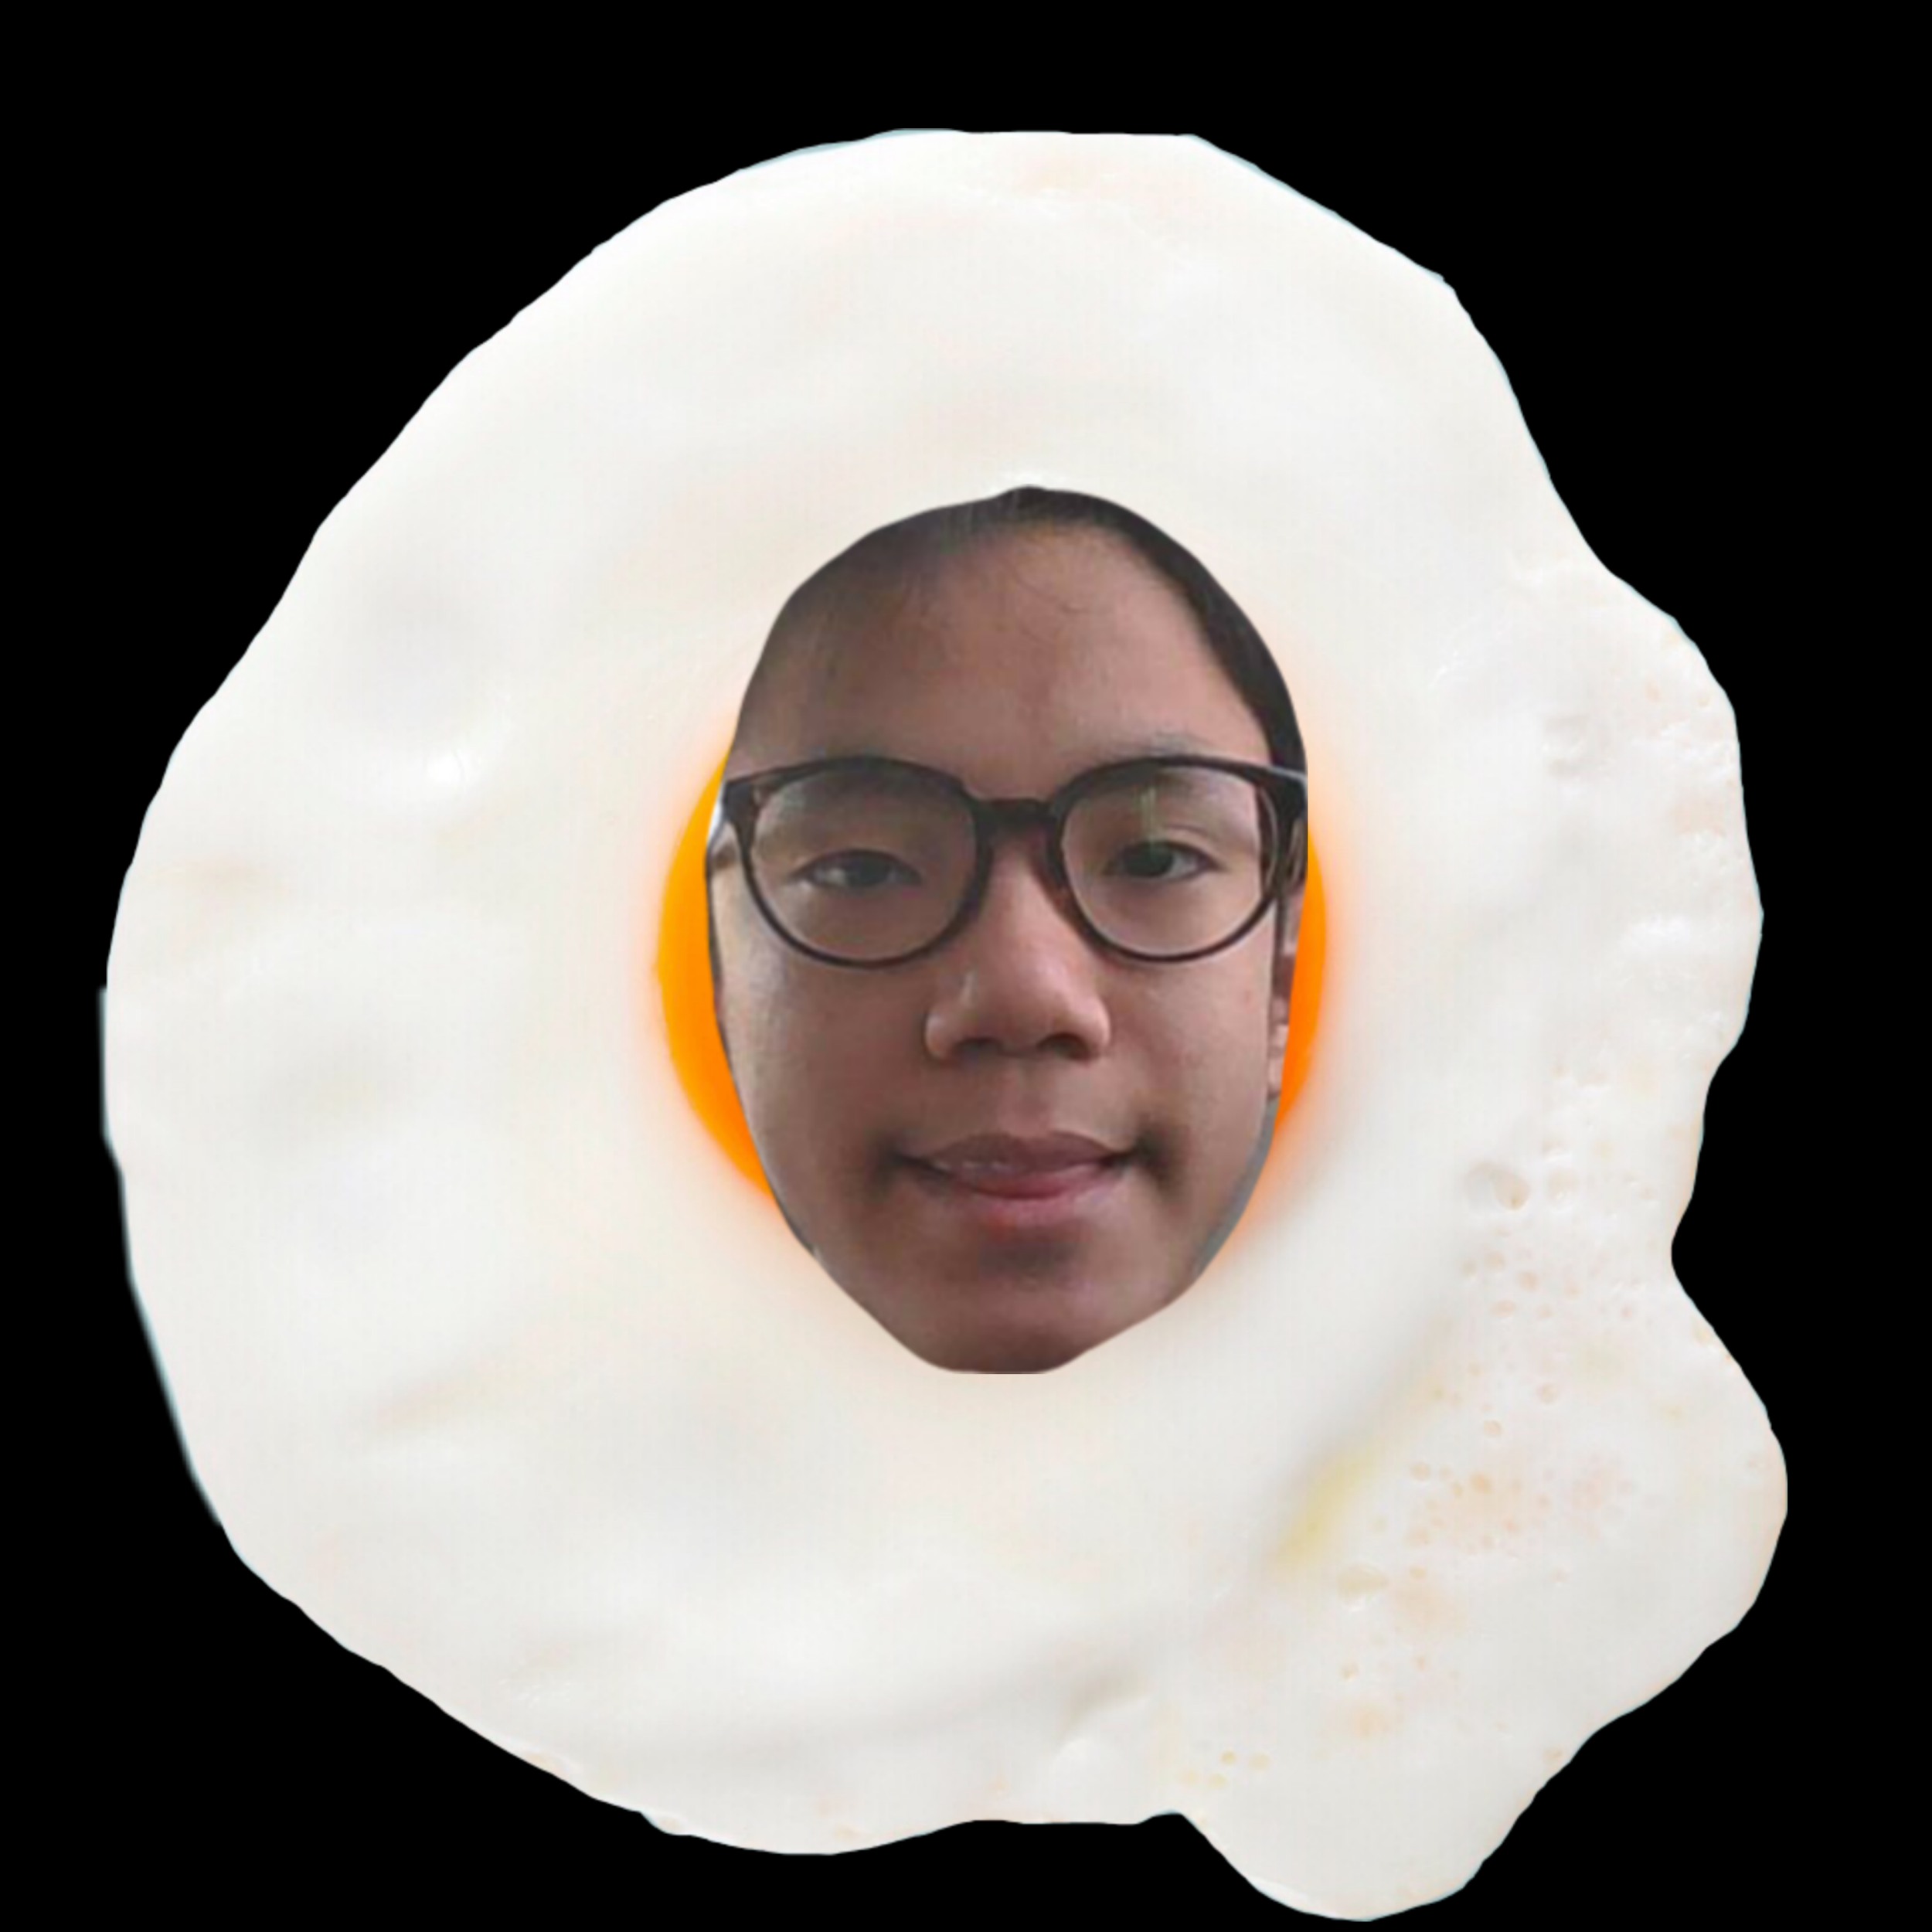

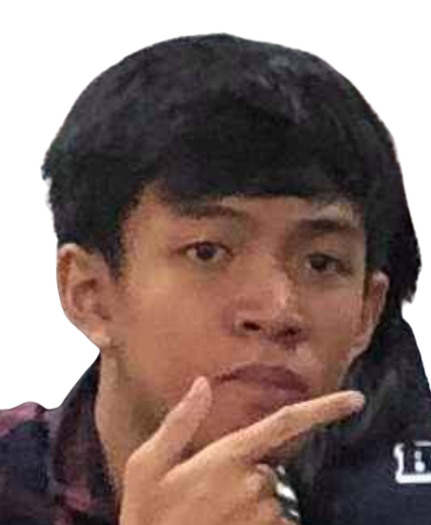


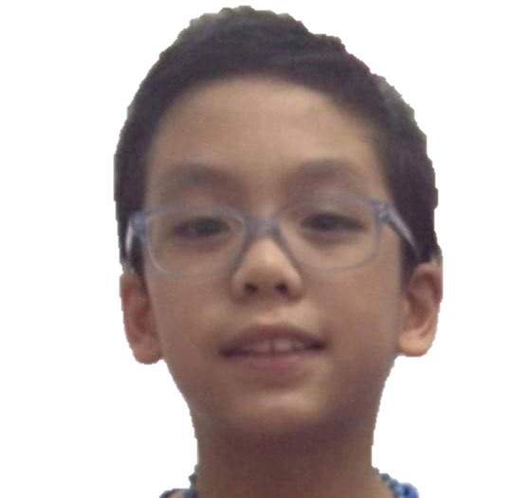
CYCLONES
THEY WILL COWER!!
JOKES OVER YOU’RE DEAD!!
Group 1: Santos, Badron, Hernandez, Leaño, Marquez, Aspera

Slide 2
What is a CYCLONE?
In meteorology, a cyclone is a large scale air mass that rotates around a strong center of low atmospheric pressure. Cyclones are characterized by inward spiraling winds that rotate about a zone of low pressure. The largest low-pressure systems are polar vortices and extratropical cyclones of the largest scale. A tropical cyclone is a storm system characterized by a low-pressure center and numerous thunderstorms that produce strong winds and flooding rain. A tropical cyclone feeds on heat released when moist air rises, resulting in condensation of water vapour contained in the moist air.

Slide 3
Things to do before a CYCLONE
Tune-in, to local news for government, announcement.
Know, when and where the cyclone, is going to hit.
Know, the important emergency, hotlines.
Never, believe, in hearsay.
Know, the characteristic, of the cyclone.
Keep, a emergency, kit/First-aid kit.
Charge, your phone.
Make, a evacuation, plan.
Check, your surroundings if there, are thing to be prepared.
Go, to the evacuation center if, you are in the danger zone.
Follow, the instructions given, by the disaster risk reduction committee

Slide 4
What to do during a CYCLONE
Stay tuned in to the television or radio for the latest news
Stay alert and prepared
Stay inside the house
Wear warm clothes
Save your batteries so you can use it for emergency purposes
Call for rescue if you are in danger

Slide 5
What to do after a CYCLONE
Check your family if they are okay
Stay tuned in to the radio and TV for the latest updates
Observe your surroundings if there are fallen trees, wrecked car, fallen electric post, and live wires (Stay away from these)
If there are damages in your house, do a repair
If there is an injury, seek for medical help

Slide 6
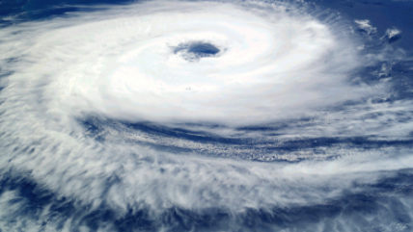
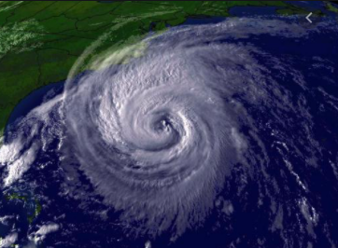
Pictures of a CYCLONE

Slide 7
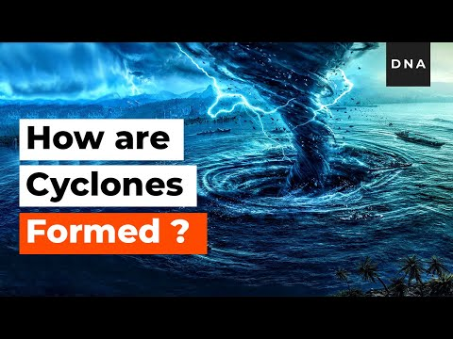
Video of a CYCLONE

Slide 8



